Slide 1

TB PACTS HACKATHON
USING EFFICACY DATA IN TB PACTS
Brian Aldana MPH, Biostatistician / Data Analyst III
Notes:
Hi there, happy to be with you this morning. My name is Brian, and I’m one of the other facilitators for today’s hackathon. Today I’m going to be doing a little demo on how to do another type of analysis, efficacy-based analysis, in a TB trial using the SimpliTB data that Mark used for his presentation. Let’s jump right in.

Slide 2
What is “efficacy” in a trial
Efficacy measures how well an intervention (drug, regimen, or other treatment) does, for example, how well it cures.
It’s one side of a many-faceted coin, but is often paired with “Safety” which, by contrast, measures how well an intervention avoids causing harmful side effects.
Mark covered some safety analyses earlier; I’m going to briefly talk about analyzing efficacy in TB trials.
But first, here is some key terminology and concepts…
Notes:
Let’s start with a broad definition of what efficacy is in the context of a clinical trial. Efficacy measures how well an intervention, it could be a drug, regimen, or any other type of treatment, performs at achieving it’s objective. The simplest example, if how well a drug do at curing a disease, but that’s just one example. Efficacy of course is only one way we measure trial outcomes, but it often is seen as one of the most important signals because if the drug in our example doesn’t cure people, then it’s basically not useful; at least in this context. Another important measurement of a drug in clinical trials is safety, which measures well an intervention avoids causing harmful side effects. Mark ran through some analysis earlier on the safety side of things, showing you how you might analyze adverse events. Now it’s my turn to take you through some efficacy analysis on TB trial data. Before we do that though, I’m going to define some things that might be helpful for you as you dig around the TB-Pacts dataset today.

Slide 3
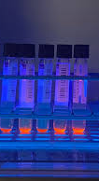
Time-to-positivity (TTP)
Efficacy is broadly defined in this context as how well a treatment regimen performed in eliminating TB in participants.
In TB trials, estimates of efficacy in trials are often derived from culture results across time in liquid (MGIT) or solid (LJ) media.
In MGIT, culture is measured by how long it takes sample to grow TB culture, measured in days. The upper bound is often capped at 42 days, at which point the culture is considered negative.
This measurement is called “time-to-positivity” and abbreviated as TTP.
Notes:
Let’s start by talking about how efficacy is measured in SimpliTB, and also in other TB trials. The first concept we’ll go over is time-to-positivity (abbrev: TTP). In TB trials, estimates of effectiveness are derived from culture results, specifically across time, and in either liquid (pictured) or solid cultures. So, cultures are taken from samples from a participant’s sputum and then watched to see how long until they start growing TB. That measurement, in days and hours, is recorded as the result, with lower being a worse outcome from an efficacy perspective. One important caveat for TB is that measurements are often capped, and if TB hasn’t grown by 42 days, the result is considered negative.

Slide 4
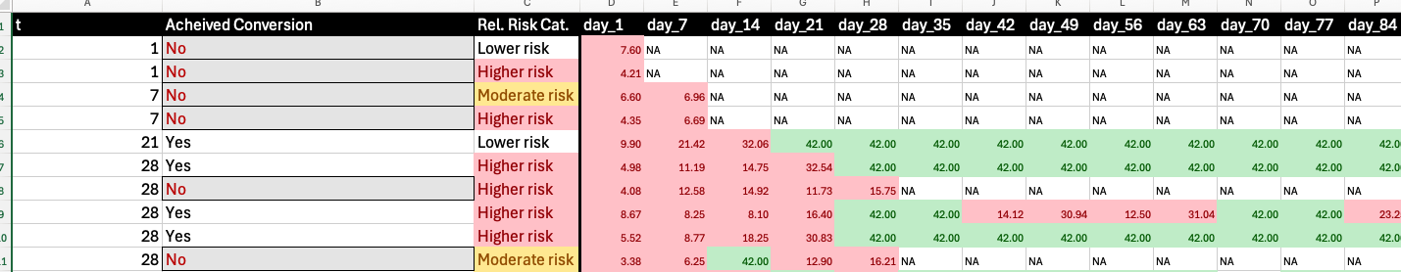
Time-to-culture-conversion (TTCC)
A TB trial will define a metric that describes stable cure in addition to TTP.
This metric may be the first 2 consecutive negative TTP results, first negative after a certain week, or some other variation on this theme.
The time it takes a participant to reach stable cure is “time to culture conversion” or TTCC.
Notes:
So, TTP provides you with a snapshot view of efficacy at a certain time point. But what we might be interested in is progression through time. How long does it take for cure to happen. Time to culture conversion (TTCC) is one way to measure that. The basic idea is that you define a metric which can be considered cure, for example, first 2 negative cultures. Then, you plot TTP and see if and when a participant achieves this metric.
Here is a screenshot of a good old fashioned excel file that graphically and textually shows TTCC. The t column represents the time, and the ”Day X” column shows the measurement at that day in the trial for the patient (one row is a patient). Then, TTP is in smaller numbers. When a participant is negative, the background changes from red to green. Don’t knock excel! It can be an excellent tool for producing high quality graphics if needed, and the interface makes it much easier to follow for certain types of analyses!

Slide 5
Other measurements
In addition to TTP and TTCC, other measurements that are thought to measure cure can be used in TB trials.
Early Bactericidal Activity, are often used in Phase 1/Phase 2A trials to get early signal.
Slope of TTP, or change in the TTP over time, is being explored to measure early response.
RS Ratio, a promising biomarker being developed for earlier and more durable protection, which Mark is working on right now.
as well as many others….!
Notes:
So, we won’t get into these in detail today, but just know there are many other estimates that are used in TB trials. An example of these are EBA, or early bactericidal activity, slope of time to positivity (TTP), and Ribosomal ratio. Also, earlier TB studies used solid media, which did not have a TTP estimate attached to it. You may encounter some of these measurements today if you choose to analyze another trial other than SimpliTB! If you have questions, I encourage you to reach out to one of the facilitators here and we can help you get oriented.

Slide 6

What is time to event (Survival) analysis?
In general, time-to-event analysis extends traditional types of analysis with a timing component.
When doing survival analysis, we don’t just consider the value of an item (linear regression) or if something occurred (logistic regression), but also when an event occurred.
Survival analysis also considers if an event occurs at all while you are observing. If the event of interest did not occur before the participant stops being observed, they are censored.
After considering these items, the metric is used to compare groups, to see if the event occurred both more or less often but also if it occurred faster or slower.
Notes:
So now, let’s pivot a little bit from TB to time-to-event/survival analysis, a bit more of a stats-y topic. As a quick refresher, survival adds another component to statistical analysis, when an event occurred, and it formalizes how to analyze time when comparing groups. This contrasts other types of analysis, which either limits to if an event occurred or not, or some sort of value associated with the event. One important consideration in survival analysis is the concept of censoring, or if we observe the event happening all to the individual. For example, if a patient is not cured by the end of the analysis period, we would say that person is censored, because we didn’t ”see” them get cured. Likewise, if a person drops out of the study, we might see them censored at an earlier time point.
Overall, the takeaway is that when conducting survival analysis, we consider not only just if something occurred more often, but if it occurred faster or slower. Which, for infectious diseases like TB, can be very important.
There are many other things to talk about when thinking about survival analysis, but those can be entire courses (or series of courses), so we won’t get into them today.

Slide 7
Survival Analysis and TTP/TTCC
So, in TB analysis, we have several statistics that explicitly or implicitly include time.
Time-to-positivity (measured in days)
Time-to-culture-conversion (derived from serial culture results)
Slope of time-to-positivity (the change in time-to-positivity across study visits)
But only TTCC is a time-to-event statistic out of these 3, because it is defined the number of days until some sort of cure event occurs.
The other values are longitudinal values, because they do consider time as part of their measurement, but they aren’t derived by evaluating a time to a specific endpoint.
Notes:
Let’s connect the dots back to TB. So, in the specific TB analyses we spoke about earlier, only TTCC qualifies as TTE/survival. This is something that has tripped up a lot of people, me included. Why? Because while it is true that other measurements can include time, only TTCC ties cure to a specific set of predefined conditions. In this case, we said: “The first 2 negative cultures means that a person has been ‘cured’, and will convert from cure = F to cure = T. “ TTP, by contrast, only takes 1 timepoint, and even though the output is a time-based metric, that time doesn’t correspond to cure, it corresponds to how quickly you saw ”bugs” in the tube. This may be correlated to how severe TB may be in that participant, but only for that specific moment in time that we took a sample from them.

Slide 8
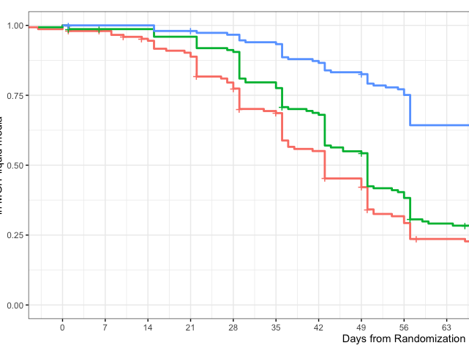
Descriptive Analysis: Kaplan Meier (KM)
Kaplan Meier Curves (KM) is a way to graphically describe time to event.
Participants are organized into groups. These groups are tracked through time, and each time a person is “cured”, “drops out” or is otherwise removed from the study, the curve reflects this movement.
At the end, the participants left on the curve, are those who have not been cured by the observation window.
You can evaluate KM curves by seeing how the lines behave over time. If one group is cured faster, one group is cured slower, if they cross at certain timepoints, or if they cross repeatedly.
Notes:
So, how are survival analyses formally assessed. One way to do this visually is to construct Kaplan Meier, or KM curves between different groups within the trial. On the x axis is time, and on the y axis are the proportion of participants, in each trial arm, who “survive” or, in this graph, who have NOT been cured. And so, visually, you can kind of see, well, which arm might lag (be higher up on the y axis) or faster (the opposite) or if they groups intermingle with one another by crossing. You can also see if you squint “+” marks are a censoring event, or when somebody becomes unobserved, for reasons other than cure.

Slide 9
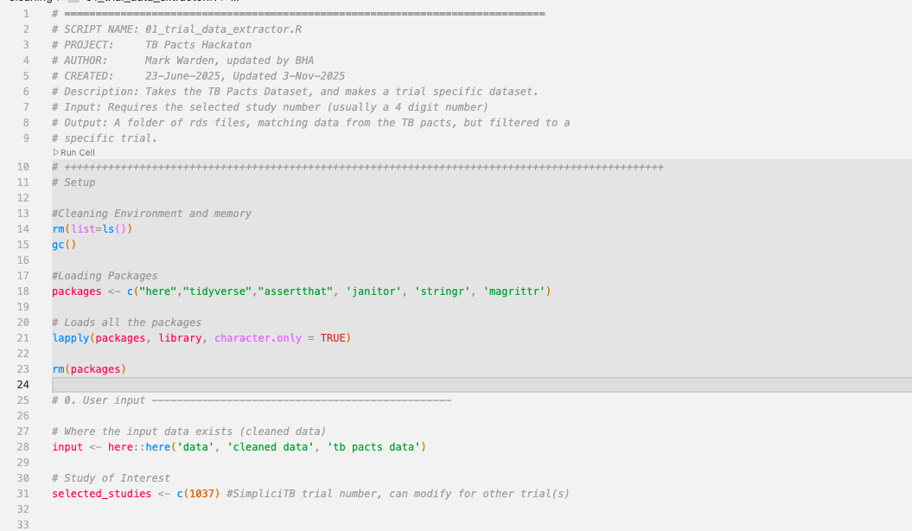
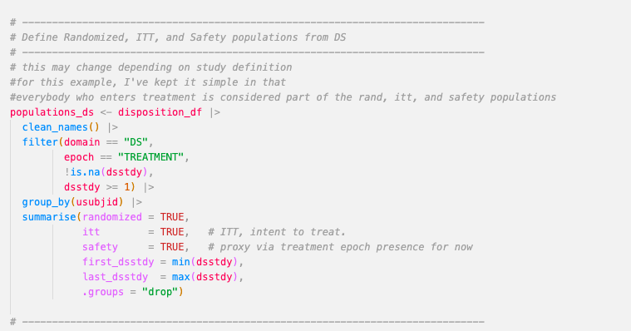
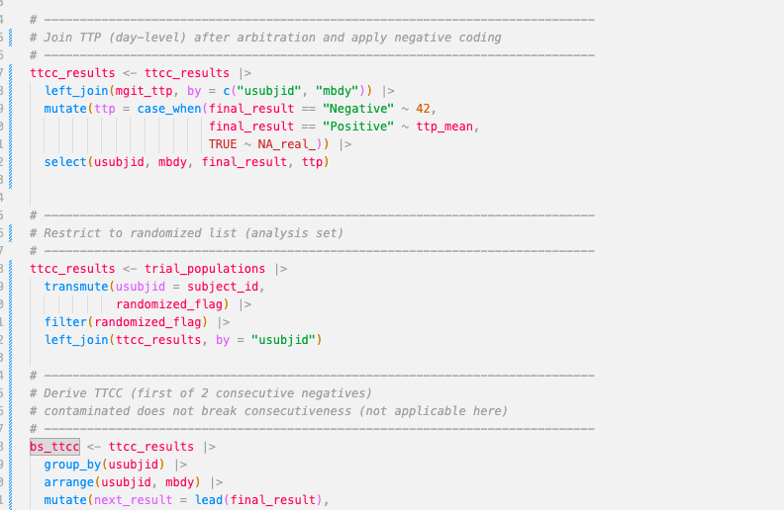
Demonstration
Notes:
So next, we are going to move into a short demonstration of the scripts that I wrote to create a KM curve for the SimpliTB trial. These scripts are similar to the helper scripts you’ve been provided with today! While this analysis focuses specifically on the SimpliciTB trial, the ones you've been given try to define things a bit more broadly, so they can potentially work with modification for other trials in TB Pacts. Big shoutout to the U-Dub team for helping here. One note as I bring this up on my screen; this is exactly the type of scripts I use on a day-to-day basis to analyze the trials I work on. Understanding and working on the TB-Pacts data will be helpful to you when and if you want to get into TB trial analysis for yourself.

Slide 10
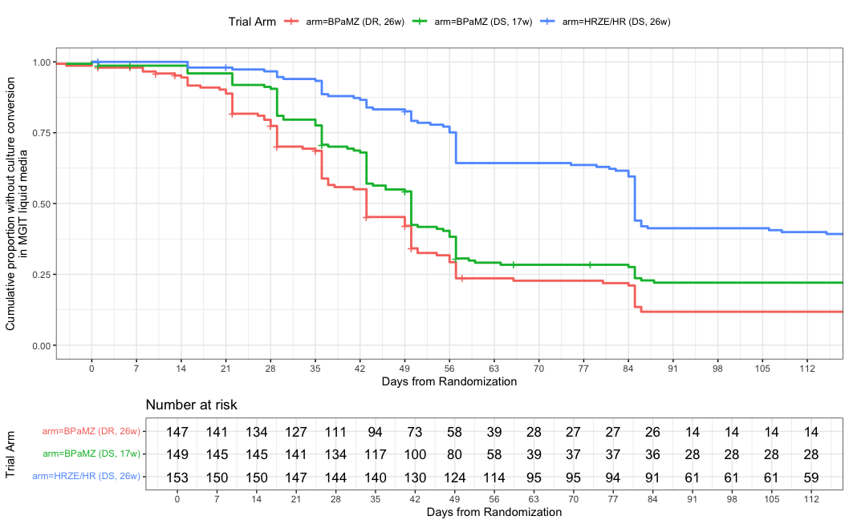
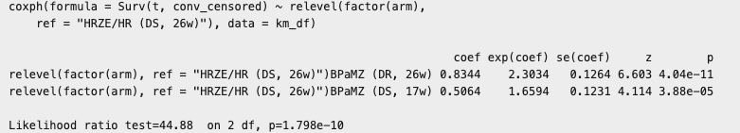
Demonstration Insights
Notes:
Now that we’ve seen how to make the KM Curve, let’s discuss the results. You say part of this screenshot earlier, but here are the curves extended to the end of the trial. What do you see? <pause> Here, we see 3 lines, representing the different trial arms. We see clearly that the blue line lags behind the others in terms of cure rates. It turns out, in SimpliTB, this was the control arm. As Mark alluded to earlier, the experimental arms outperformed the control arms in terms of efficacy in this trial, and we see this clearly in the Kaplan-Meier curves produced. We also see that both the red and green arms performed about the same. We might formalize this by constructing confidence intervals, but upon first glance, we might both the red and green group probably aren’t significantly different given the numbers at risk. Hard to say though, we certainly have more work to do! I also printed out the results of a Cox model in the bottom right, a more numerical representation of this type of analysis. We see that, in comparison to the control arm, the red and green arms have a hazard ratio of 1.66, and 2.30, respectively. This means that, after considering time and censoring, the rate of conversion was significantly higher than the control, which is the reference and not displayed. The p values on the right-hand side confirm this result.

Slide 11
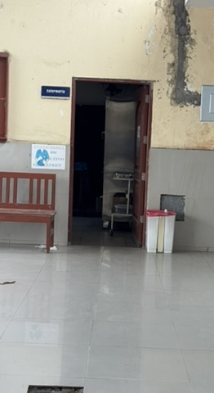
Ideas for further analysis
So, if you wanted to extend this analysis for Hack Day..
You could consider doing the same type of analysis on a different trial.
You could consider using the same trial, but defining your groups differently (by biological sex, age, control vs. everything else)
You can derive your own definition for time-to-culture-conversion
You could consider other models, such as Cox PH or multi-level models.
You can try to aggregate results from more than one trial.
Notes:
Okay, so as you go forth today and consider your own analyses, I wanted to end with some ideas on how you might take what you saw here and carry it forward to your own hack today. One clear thing you might want to do is consider this analysis for another trial. Or you could, instead of stratifying by arm, you might consider pulling in some demographic data, for example, and stratifying by another variable. You could also decide to define TTCC a bit differently, other definitions I have run into is NO additional positive cultures as the time-to-event, or having 2 negative cultures, but with them having to be at a certain length apart (28 days or 1 month comes to mind). You also might choose to focus on other models or combine results for more than one trial. One word of caution, not all trials have the same fields of data, so investigate that first if you are interested!
Finally, I wanted to just make a quick plug to explore these data, and not necessarily to think about replicating trial results perfectly. It’s often hard to copy the exact analysis that is presented in a paper and redo the graphs from that paper. Why? Because, other than style, trials often have rules about who is included in the final analysis, specific censoring or even cure rules that might lead you to dig into the documentation for the trial. The goal today should be to try and put something together within the span of our day. Replicating a trial exactly, even a well documented one, is more than than we have! Above all, go out and have fun. Explore what interests you. And then, if this continues to interest you afterwards, you should get in touch with us to continue your work.

